Slide 1
SE-2001
Software Requirement Engineering
II. Requirements Engineering Processes
Dr. Abdul Aziz
Department of Software Engineering
School of Computing
1

Slide 2
Requirements engineering concepts
Defining requirements:
IEEE defines requirements as:
  A condition or capability needed by a stakeholder to solve a problem or achieve an objective.
  A condition or capability to be met or possessed by a solution or solution component to satisfy a contract, standard, specification, or other formally imposed documents.
  A requirement may be unstated, implied by or derived from other requirements, or directly stated and managed.

Slide 3
Requirements engineering concepts (cont…)
One of the key objectives of requirements engineering is to ensure requirements are visible to and understood by all stakeholders.
Conditions or capabilities in an enterprise:
  Organizational structures,
  Roles,
  Processes,
  Policies,
  Rules
  Information systems.

Slide 4
Functional requirements
Categories of functional requirements are:
User interface perspective (UI): Interactions between users and application are described.
Data perspective (Data): Data aspects are described.
Functional perspective (Logic): Functional perspectives describe data flows or logic flows of the system.
Behavioral perspective (State): Statuses of data elements are described.

Slide 5
Non-Functional requirements
The umbrella term “non-functional requirement” is often used for quality requirements and constraints.
Quality requirements describe qualities of a system that are important to:
  User community, such as usability, learnability, reliability, etc.
  Development community, such as scalability, maintainability, reusability, etc.

Slide 6
Processes
A process is an organized set of activities which transforms inputs to outputs
Process descriptions encapsulate knowledge and allow it to be reused
Examples of process descriptions
  Instruction manual for a dishwasher
  Cookery book
  Procedures manual for a bank
  Quality manual for software development
RE-2 <number>

Slide 7
Design processes
Processes which involve creativity, interactions between a wide range of different people, engineering judgment and background knowledge and experience
Examples of design processes
  Writing a book
  Organizing a conference
  Designing a processor chip
  Requirements engineering
RE-2 <number>

Slide 8
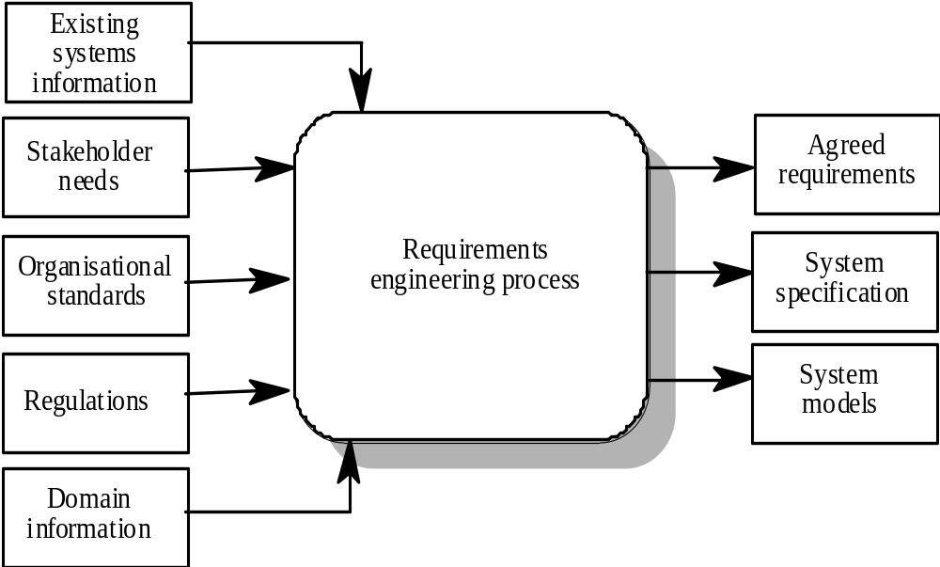
RE process - inputs and outputs
RE-2 <number>

Slide 9
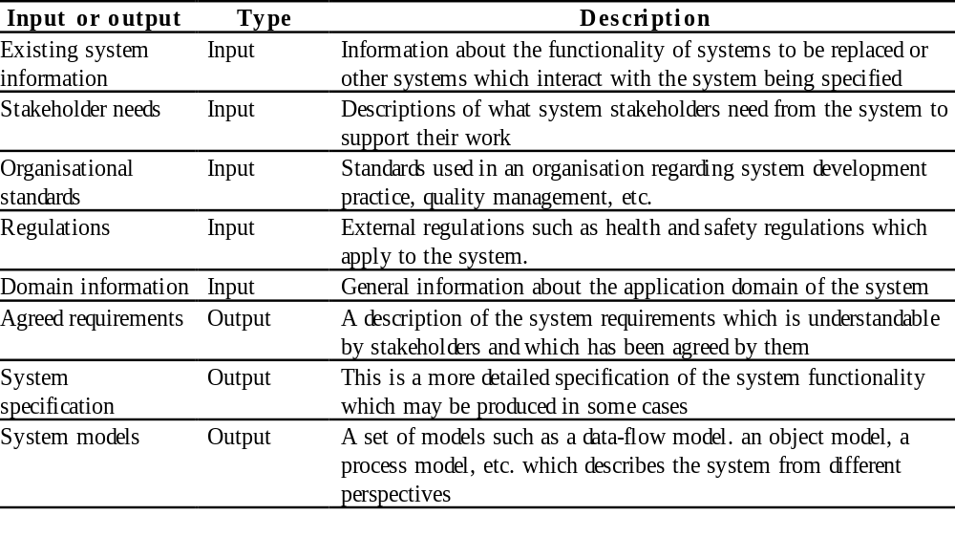
Input/output description
RE-2 <number>

Slide 10
RE process variability
RE processes vary radically from one organization to another
Factors contributing to this variability include
  Technical maturity
  Disciplinary involvement
  Organizational culture
  Application domain
There is therefore no ‘ideal’ requirements engineering process
RE-2 <number>

Slide 11
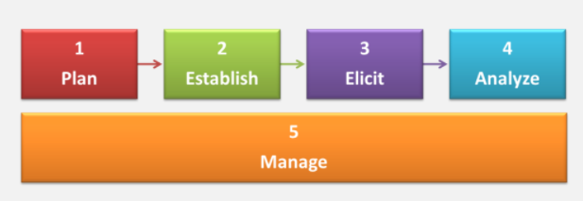
Major Activities in RE
RE-2 <number>

Slide 12
Plan RE
During planning,
Requirements engineers understand system:
  objectives,
  scope,
  boundary and
  plan for requirements engineering resources and activities.
RE-2 <number>

Slide 13
Establish RE infrastructure
During this phase, requirements engineer
Organize requirements engineering resources and
Establish various practices to continue with requirements engineering.
RE-2 <number>

Slide 14
Elicitation
Elicitation means to
“Understand underlying needs” and
“To draw forth – to enquire till all necessary information are obtained”.
Key objectives for elicitation are:
  Elicit requirements from stakeholders and other sources using different elicitation techniques.
  Elicit various attributes of requirements.
RE-2 <number>

Slide 15
Analysis
During analysis, requirements engineers organize, prioritize and model requirements. They also verify and validate requirements.
RE-2 <number>

Slide 16
Requirements management
Requirements management is an ongoing activity which spans across all other requirements activities.
Key objectives for requirements management are:
  Manage requirements from creation till decommissioning of requirements,
  Manage requirements changes, conflicts and issues.
RE-2 <number>

Slide 17
Process models
A process model is a simplified description of a process presented from a particular perspective
Types of process model include:
  Coarse-grain activity models
  Fine-grain activity models
  Role-action models
  Entity-relation models
RE-2 <number>

Slide 18
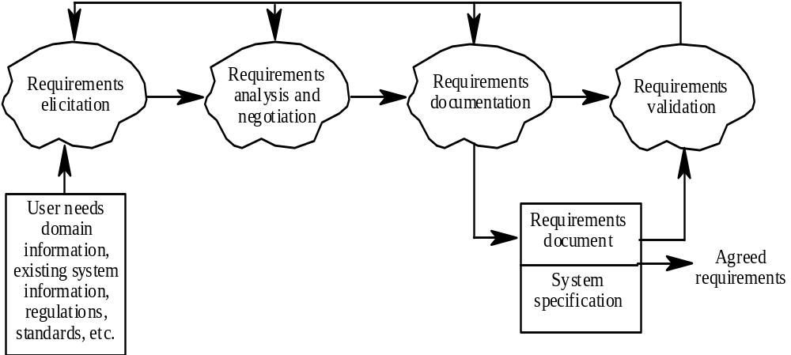
Coarse-grain activity model of RE
RE-2 <number>

Slide 19
RE process activities
Requirements elicitation
  Requirements discovered through consultation with stakeholders
Requirements analysis and negotiation
  Requirements are analyzed and conflicts resolved through negotiation
Requirements documentation
  A requirements document is produced
Requirements validation
  The requirements document is checked for consistency and completeness
RE-2 <number>

Slide 20
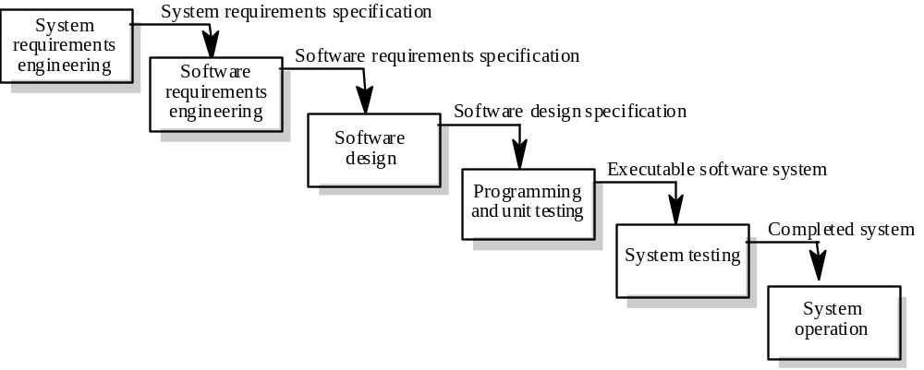
Waterfall model of the software process
RE-2 <number>

Slide 21
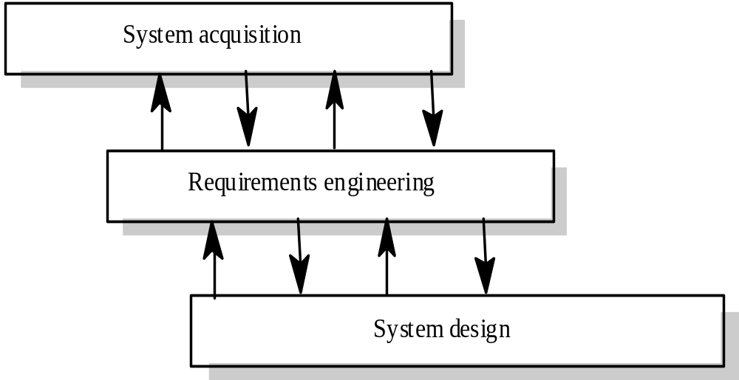
Context of the RE process
RE-2 <number>

Slide 22
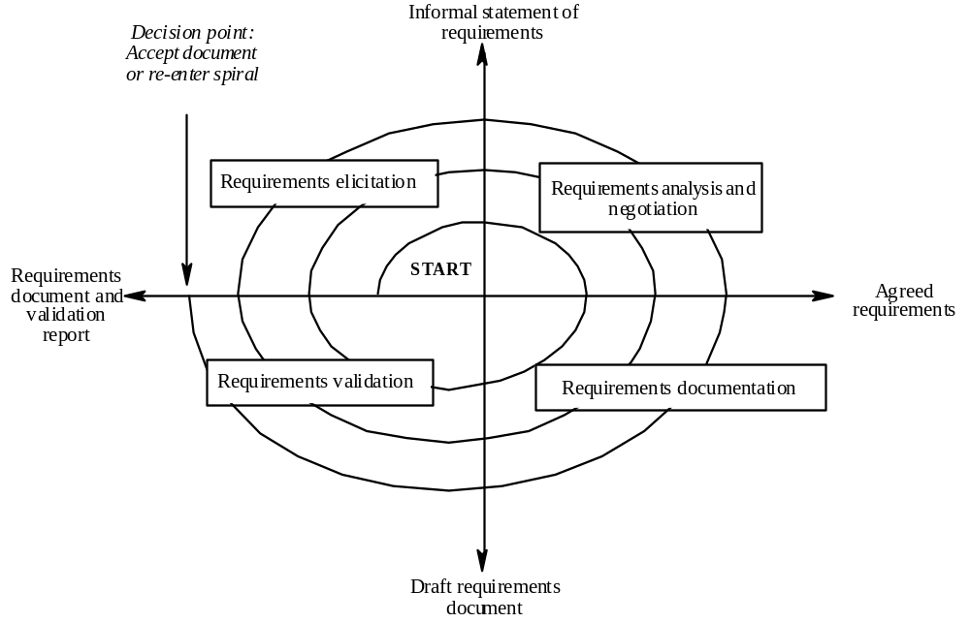
Spiral model of the RE process
RE-2 <number>

Slide 23
Actors in the RE process
Actors in a process are the people involved in the execution of that process
Actors are normally identified by their roles rather than individually
Requirements engineering involves actors who are primarily interested in the problem to be solved (end-users, etc) as well actors interested in the solution (system designers, etc.)
Role-action diagrams document which actors are involved in different activities
RE-2 <number>

Slide 24
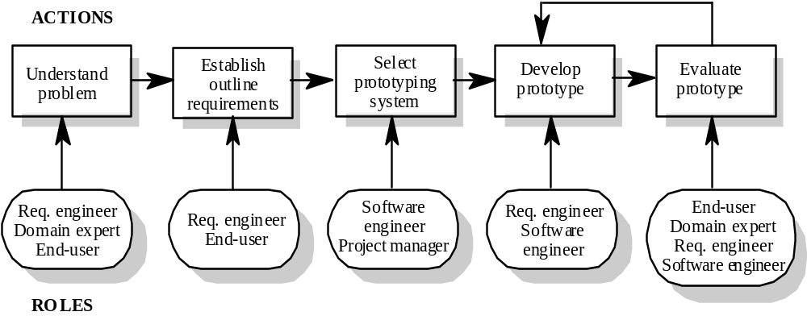
RAD for software prototyping
RE-2 <number>

Slide 25
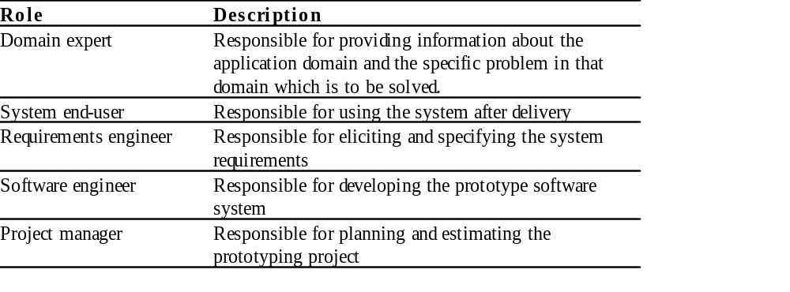
Role descriptions
RE-2 <number>

